Slide 1
Data Science Engineering Methods and Tools Lecture 5
Northeastern University
College of Engineering
Multidisciplinary Graduate Engineering Department
INFO 6105 – Fall 2025
Instructor: Abdolreza Mosaddegh

Slide 2
Announcement
TA: Haoqi Shen
Email / Teams : shen.haoq@northeastern.edu
Office Hours: Mondays and Tuesdays (10:00-12:00)

Slide 3
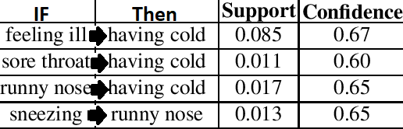
Association Rules
Association rule mining is an unsupervised machine learning approach for investigating interesting associations between items in large datasets.
Association rules (X → Y) are if-then statements that represent the relationship between antecedent (X) and consequent (Y) items in data transactions.
Association rules do not represent any sort of causality between X and Y.
X ⇒ Y does not mean X causes Y, so no causality
Minimum Requirements for Causal Relationships:
Statistically significant association / covariation
Temporal precedence (X happens before Y)
No confounders (a third variable)
Plausible explanation of how X leads to Y
Consistent and replicable across studies

Slide 4
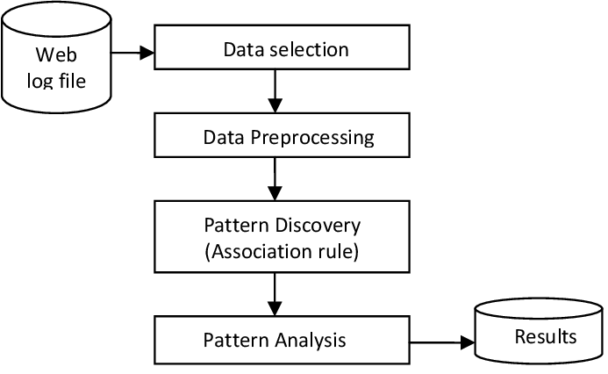
Association Rule Mining
Association rules predict the occurrence of items based on the occurrences of other items
They can be used to extract patterns inside the data (e.g., buying pattern, genetic patterns, behavioral patterns, etc.)
Association rules are directional, but they don't not consider the order of items
X ⇒ Y can be different from Y ⇒ X no symmetry (unlike correlation)
X, Y ⇒ U,V is equal to Y, X ⇒ V,U no order in items
https://www.semanticscholar.org/paper/Association-Rule-Mining-among-web-pages-for-Usage-Mohan-Gopal/2e7bb4d487e8004f826bd8241c3c88a17975daf1

Slide 5
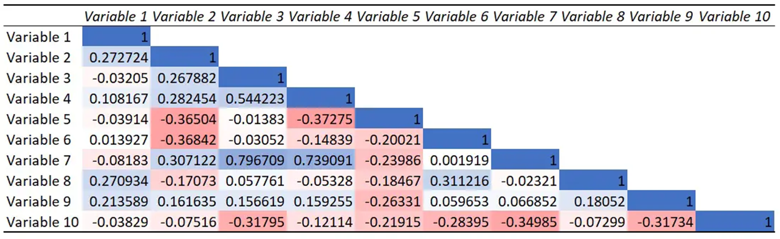
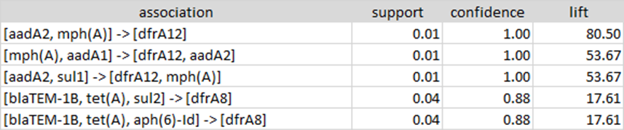
ARM vs Association Metrics
Association Metrics: Captures pairwise (one variable vs. another) and simple and nondirectional relationships only (e.g., Pearson Correlation, Mutual Information)
Association Rule Mining:
Can capture multi-item dependencies which correlation cannot. Example: Patients with both {fever, cough} are associated with Covid diagnosis.
Chooses a direction for interpretability and actionability. Example: {smoking, High BMI} → {Cancer} doesn’t imply Cancer leads to smoking and high BMI.
Provides conditional (if–then) associations which are actionable for Healthcare & Medicine, Bioinformatics & Genomics, Fraud Detection & Security
Employs interestingness measures to select important associations

Slide 6
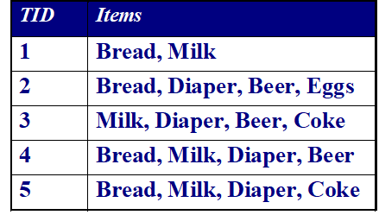
Terminology
Transaction can be a set of genes in a bacterium
Transactional Data:
ARM typically operates on transactional data
Transactional data is a collection of transactions
Transaction indicates co-occurrence of data items
Each transaction is a set of items that occur together
Itemset:
A collection of one or more items that occur together within transactions in a transactional data
A 1-itemset contains one item (e.g., 1-itemset: {Bread})
A k-itemset contains k items (e.g., 2-itemset: {Milk, Coke})
Each transaction can be a market basket of a customer

Slide 7
Characteristics of Transactional Data
Sparse: The data is often sparse (many items are not present in most transactions)
Categorical: Items are usually categorical (not numerical).
No Explicit Order: Transactions are treated as unordered sets of items.
No Time Dependency: The temporal sequence of items is not considered (but time can be encoded as an item)
T1 | {Milk, Bread}
T2 | {Bread}
T3 | {Milk. Egg}
Binary Representation: A common way to store transactions is a binary matrix, where:
Rows represent transactions
Columns represent items
A cell is 1 (or True) if the item is in the transaction, otherwise 0 (or False).
Transaction | Milk | Bread | Eggs
T1 | 1 | 1 | 0
T2 | 0 | 1 | 0
T3 | 1 | 0 | 1

Slide 8
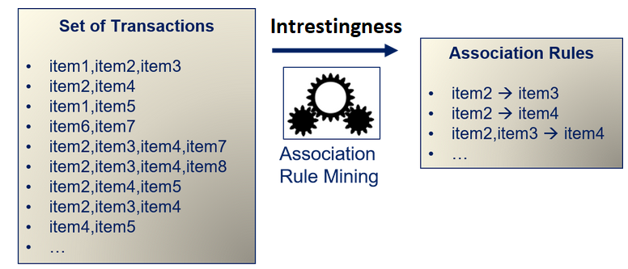
Objective Function - Interestingness
We are not looking for all type of associations:
Usually, associations which are not frequent (e.g., noise) are not interesting
Associations which are not strong (no real association) are not interesting
Associations which are not reliable are not interesting
Problem:
We need some measures for interestingness

Slide 9
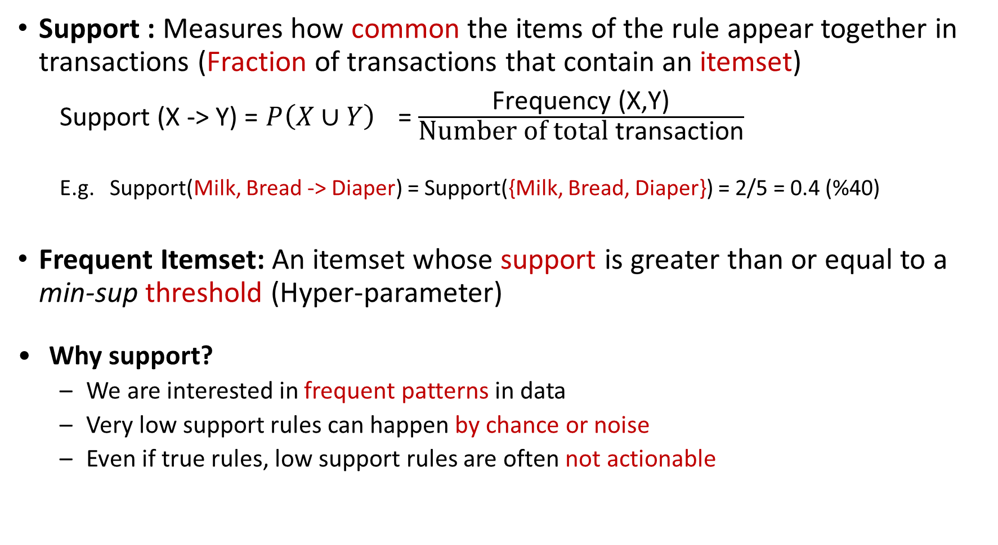
Interestingness Measures - Support
Support : Measures how common the items of the rule appear together in transactions (Fraction of transactions that contain an itemset)
Support (X -> Y) = $P\left(X∪Y\right)$ = $\frac{\text{F}\text{requency}\text{ (}\text{X}\text{,}\text{Y}\text{)}}{\text{Number} \text{of} \text{total} \text{transaction}}$
E.g. Support(Milk, Bread -> Diaper) = Support({Milk, Bread, Diaper}) = 2/5 = 0.4 (%40)
Frequent Itemset: An itemset whose support is greater than or equal to a min-sup threshold (Hyper-parameter)
Why support?
We are interested in frequent patterns in data
Very low support rules can happen by chance or noise
Even if true rules, low support rules are often not actionable
TID
Items
1
Bread, Milk
2
Bread, Diaper, Beer, Eggs
3
Milk, Diaper, Beer, Coke
4
Bread, Milk , Beer, Diaper
5
Bread, Milk, Diaper, Coke

Slide 10
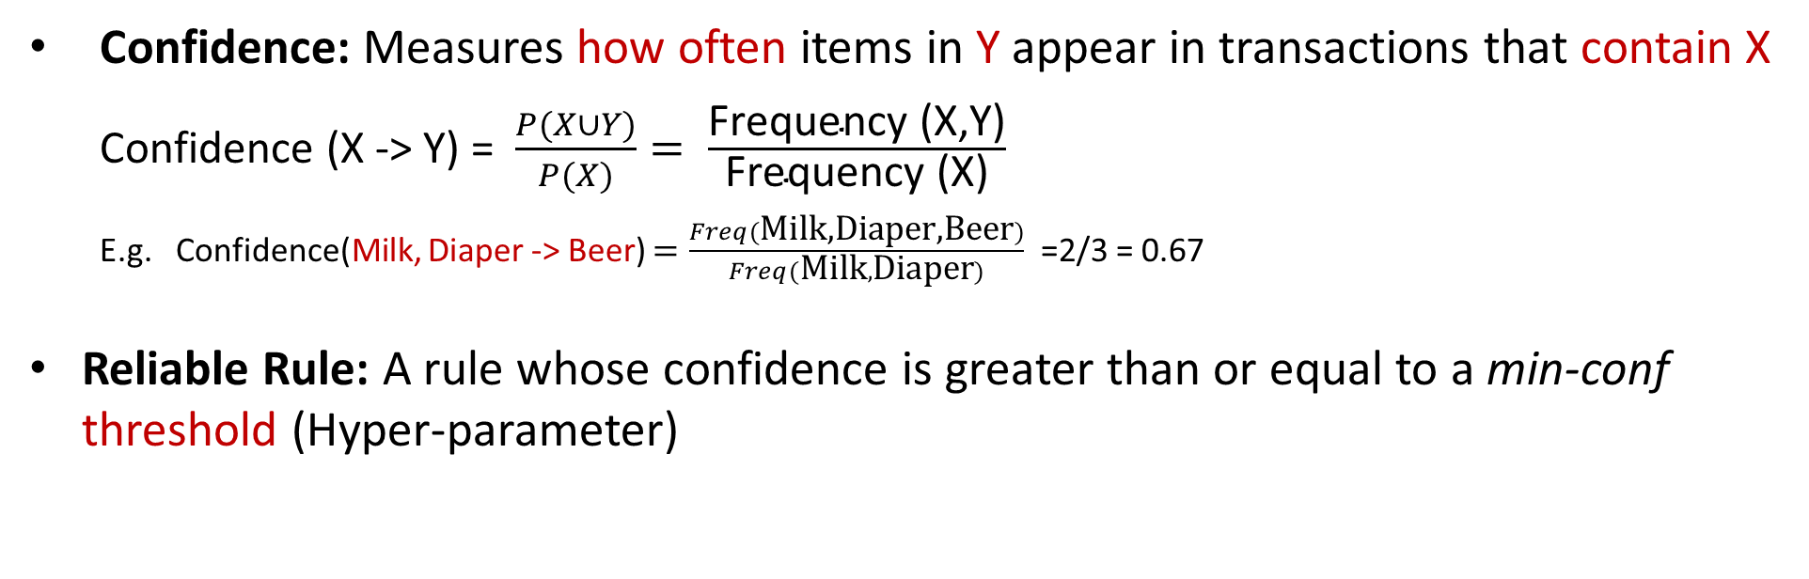
Interestingness Measures - Confidence
Confidence: Measures how often items in Y appear in transactions that contain X
Confidence (X -> Y) = $\frac{P(X∪Y)}{P(X)}= \frac{\text{Frequency}\text{ (}\text{X}\text{,}\text{Y}\text{)}}{\text{Frequency}\text{ (}\text{X}\text{)}}$
E.g. Confidence(Milk, Diaper -> Beer) $=\frac{Freq(\text{Milk}\text{,}\text{Diaper}\text{,}\text{Beer})}{Freq(\text{Milk},\text{Diaper})}$ =2/3 = 0.67
Reliable Rule: A rule whose confidence is greater than or equal to a min-conf threshold (Hyper-parameter)
Why confidence?
Rules with low confidence are not reliable
Rules with high confidence can serve as predictive tools
High-confidence rules are more actionable (e.g., for decision making)
TID
Items
1
Bread, Milk
2
Bread, Diaper, Beer, Eggs
3
Milk, Diaper, Beer, Coke
4
Bread, Milk, Diaper, Beer
5
Bread, Milk, Diaper, Coke

Slide 11
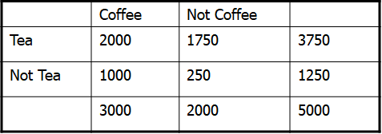
Misleading Interesting Measures
In a rule (X -> Y), if Y is very common in the dataset, then confidence will be high, even if there is no real association between X and Y
1) drink Coffee ⇒ drink tea
Sup = 2000/5000 = 40%
Conf = 2000 /3000 = 66.7%
2) drink Coffee ⇒ not drink tea [33.3%]
Sup = 1000/5000 = 20% (Lower Support than rule 1)
Conf = 1000 /3000 = 33.3 % (Lower Confidence than rule 1)
Summarized Transactions
66.7% is misleading since 3750 out of 5000 (75%) in the population drink tea. Therefore, drinking tea has negative impact on drinking coffee. The second rule is more realistic, although it has lower support and confidence

Slide 12
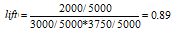
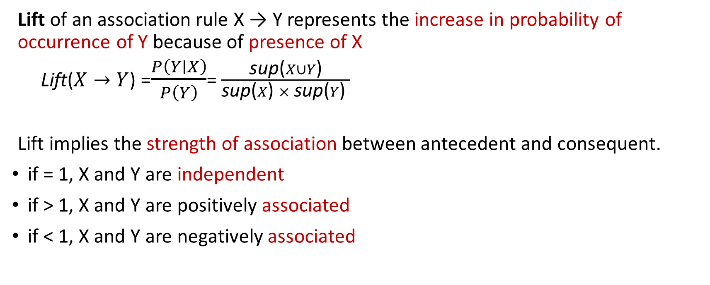
Interestingness Measures - Lift
Lift of an association rule X → Y represents the increase in probability of occurrence of Y because of presence of X
Lift($X→Y$) =$\frac{P\left(Y∣X\right)}{P\left(Y\right)}$= $\frac{\text{sup}\text{(}X∪Y\text{)}}{\text{sup}\text{(}X\text{)} × \text{sup}\text{(}Y\text{) }}$
Lift implies the strength of association between antecedent and consequent.
if = 1, X and Y are independent
if > 1, X and Y are positively associated
if < 1, X and Y are negatively associated
drink Coffee ⇒ drink tea [66.7% Conf]
drink Coffee ⇒ not drink tea [33.3% Conf]

Slide 13
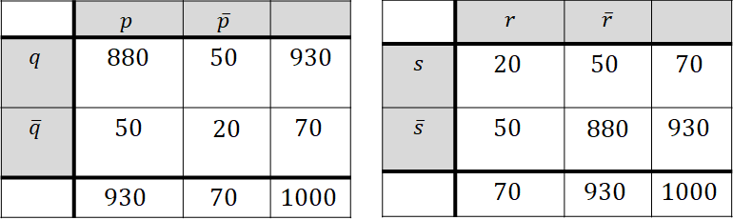
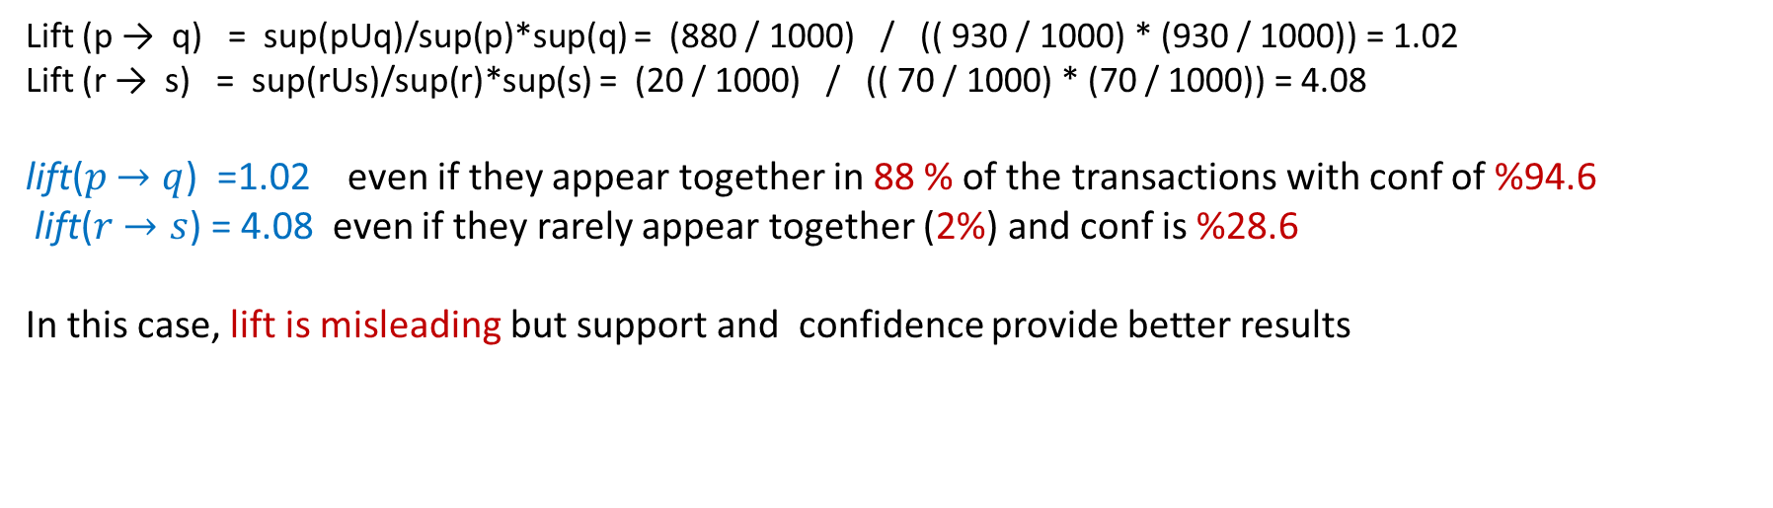
Combination of Interestingness Measures
In a rule (X->Y) If X and Y both occur rarely, even a few co-occurrences can make Lift very large
Lift can also be misleading if it is used as the only criterion of interestingness
A combination of interestingness measures is required to extract meaningful association rules
Lift (p → q) = sup(pUq)/sup(p)*sup(q) = (880 / 1000) / (( 930 / 1000) * (930 / 1000)) = 1.02
Lift (r → s) = sup(rUs)/sup(r)*sup(s) = (20 / 1000) / (( 70 / 1000) * (70 / 1000)) = 4.08
lift($p$ $→q$) =1.02 even if they appear together in 88 % of the transactions with conf of %94.6
lift($r$ $→s$) = 4.08 even if they rarely appear together (2%) and conf is %28.6
In this case, lift is misleading but support and confidence provide better results

Slide 14
Subjective vs Objective Measures
Objective measures:
Rank patterns based on quantitative interestingness measures of association such as support, confidence, lift, etc.
Subjective measures:
Rank patterns according to subject matter expert’s interpretation:
A pattern is subjectively interesting if it contradicts the expectation of a user
e.g., a rare (low support) sequence of genes
A pattern is subjectively interesting if it is actionable
e.g., a pattern of fraud / money laundering (with low support) in financial transactions

Slide 15
Rule Mining - Problem Statement
Given a set of transactions, the goal of is to find all rules having:
Support ≥ min-sup threshold (Hyper-parameter)
Confidence ≥ min-conf threshold (Hyper-parameter)
Lift ≥ min-lif threshold (Hyper-parameter)
Other measures (if applicable)
For this purpose, three steps are required:
Finding Frequent Itemsets (to satisfy support requirement)
Find all itemsets whose support ≥ min-sup
Generation of Reliable Rules (to satisfy confidence requirement)
Generate reliable rules with confidence ≥ min-conf from frequent itemsets
3. Filtering Rules (to satisfy lift and other requirements)
Filter rules with low lift, … from rules
{A,B,C} is a frequent itemset then:
AB →C, AC →B, and BC →A rules are frequent

Slide 16
Finding Frequent Itemsets - Brute-force
In brute-force approach:
Each itemset is a candidate frequent itemset
Count the support of each candidate by scanning the database
Brute-force approach is computationally expensive in large datasets
Transactions
List of
TID
Items
Candidates
1
Bread, Milk
2
Bread, Diaper, Beer, Eggs
N
3
Milk, Diaper, Beer, Coke
4
Bread, Milk, Diaper, Beer
M
5
Bread, Milk, Diaper, Coke
w
Match each transaction against every candidate

Slide 17
Candidate Itemset Generation- Brute-force
Given d items, there are 2^{d} possible candidate itemsets.
It is computationally expensive to calculate support for all of them
Combinations of 5 different items (A,B,C,D,E)

Slide 18
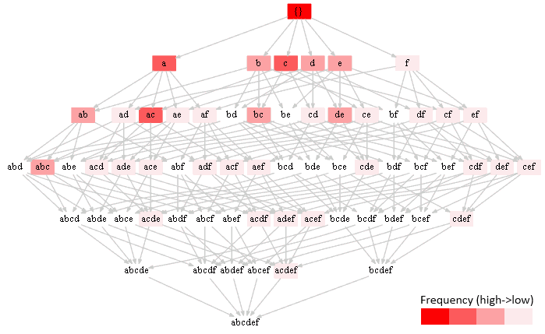
Finding Frequent Itemsets - Optimization
There are two main approaches to optimize finding of frequent itemsets:
1- Reduce the number of candidates
Use pruning techniques to reduce candidates e.g. , Apriori, Eclat.
2- Reduce the number of comparisons
Use efficient data structures (e.g., FP-tree) to store the candidates
No need to compare every candidate against every transaction

Slide 19
Reducing Number of Candidates
Apriori is one of the most common approach to reduce number of candidate
Apriori principle:
If an itemset is infrequent, then all of its supersets must also be infrequent
Apriori principle holds due to the following property of the support measure:
Support of an itemset never exceeds the support of its subsets

Slide 20
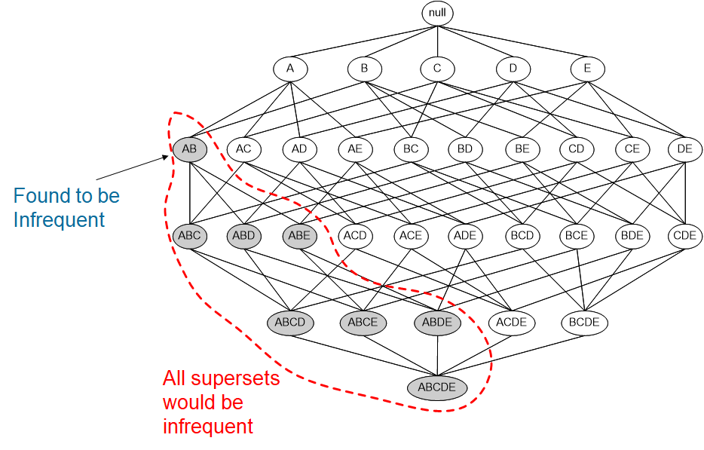
Apply Apriori Principle
If an itemset is infrequent, then all of its supersets can be pruned
Apriori can handle large datasets more efficiently and avoids generating and testing useless candidates

Slide 21
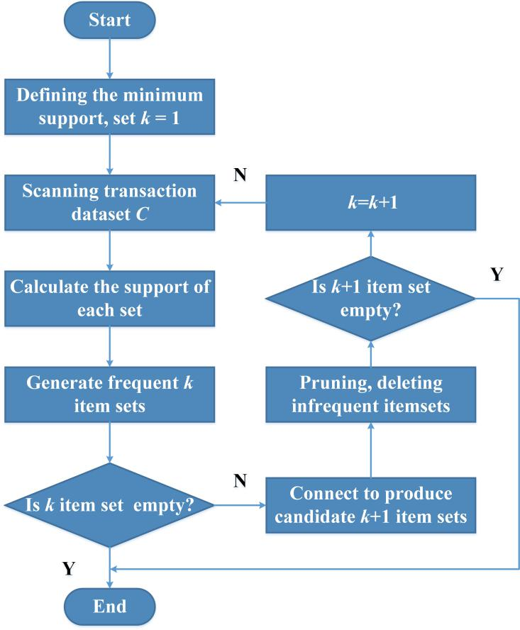
Apriori Steps
1-Generate frequent 1-itemsets​:
Count each single item’s support
Keep only items with support ≥ minsup.
2-Iterative Candidate Generation:
Use frequent (k−1)-itemsets to generate candidate k-itemsets
3-Prune Candidates:
Prune candidate if at least one of its subsets is not frequent
4-Count Support:
Scan database to count support of each candidate
5-Select Frequent Itemsets:
Keep those ​that meet minsup ​
6-Repeat until no new frequent itemsets can be generated.

Slide 22
Apriori Example–Length 1
80%
60%
80%
80%
A B C D
Transactions:
{A, B, D}
{A, C, D}
{A, B, C, D}
{B, C, D}
{A, C}
minSup = 50%

Slide 23
Apriori Example–Length 2
A B C D
A,B A,C A,D B,C B,D C,D
Transactions:
{A, B, D}
{A, C, D}
{A, B, C, D}
{B, C, D}
{A, C}
minSup = 50%
40%
60%
60%
40%
60%
60%

Slide 24
Apriori Example–Length 3
A B C D
A,B A,C A,D B,C B,D C,D
A,B,C A,B,D A,C,D B,C,D
Transactions:
{A, B, D}
{A, C, D}
{A, B, C, D}
{B, C, D}
{A, C}
minSup = 50%

Slide 25
Apriori Example – Final Results
A B C D
A,B A,C A,D B,C B,D C,D
A,B,C A,B,D A,C,D B,C,D
Transactions:
{A, B, D}
{A, C, D}
{A, B, C, D}
{B, C, D}
{A, C}
minSup = 50%
Frequent Itemsets = {A,B,C,D,AC,AD,BD,CD}
40%

Slide 26
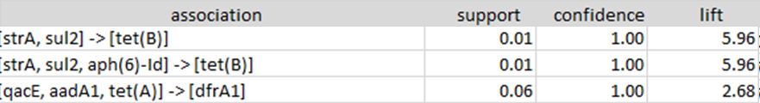
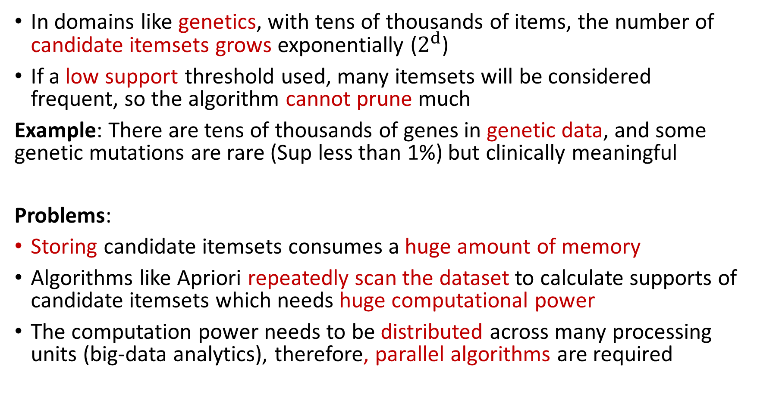
Frequent Itemset Mining - Challenges
In domains like genetics, with tens of thousands of items, the number of candidate itemsets grows exponentially ($2^{d}$)
If a low support threshold used, many itemsets will be considered frequent, so the algorithm cannot prune much
Example: There are tens of thousands of genes in genetic data, and some genetic mutations are rare (Sup less than 1%) but clinically meaningful
Problems:
Storing candidate itemsets consumes a huge amount of memory
Algorithms like Apriori repeatedly scan the dataset to calculate supports of candidate itemsets which needs huge computational power
The computation power needs to be distributed across many processing units (big-data analytics), therefore, parallel algorithms are required

Slide 27
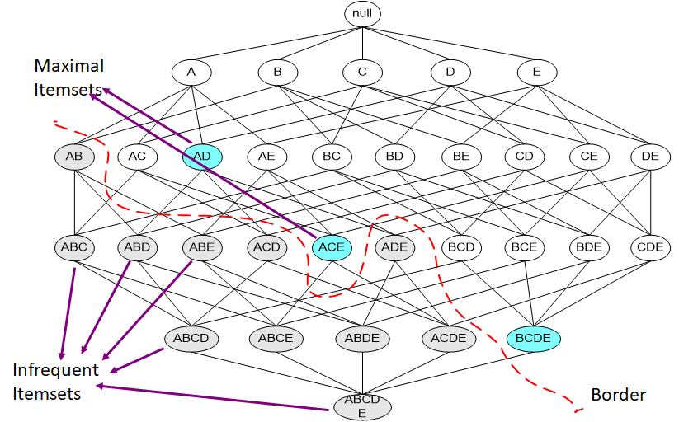
Compact Representation - Maximal Frequent Itemset
An itemset is maximal frequent if none of its immediate supersets is frequent.
Identify a small representative set from which every frequent itemset can be derived.
Provides a compact representation of all the frequent itemsets

Slide 28
Maximal Frequent Itemset - Example
Support Count Threshold = 2 (Support = 50%)
Maximal Frequent Itemsets = {ab,ac,ad}
Frequent Itemsets = {ab,ac,ad, a,b,c,d}
Problem: maximal frequent itemsets does not provide any information about the support count of other itemsets

Slide 29
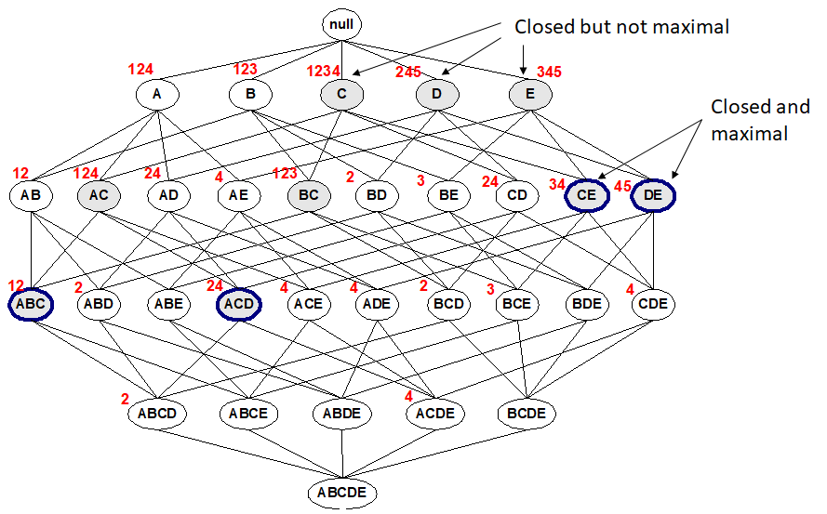
Closed Frequent Itemsets
A frequent itemset is closed, when no immediate superset has the same support.
All frequent itemsets and their support can be derived from the closed frequent itemsets.
Closed itemset is larger than maximal itemset but the support of all frequent itemsets can be derived
# Closed = 9
# Maximal = 4
Red Numbers = TIDs
Minimum support = 2

Slide 30
Closed Frequent Itemset - Example
Closed Frequent Itemsets = {a(s=4), ab(s=2) ,ac(s=2), ad(s=2)}
Frequent Itemsets = {a(s=4), ab(s=2), ac(s=2), ad(s=2), b (s=2), c(s=2), d(s=2)}
Support Threshold = 2

Slide 31
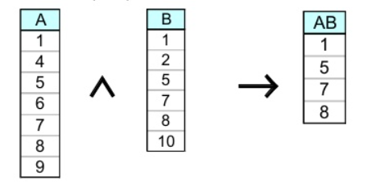
Eclat Algorithm
The Eclat (Equivalence Class Clustering and bottom-up Lattice Traversal) is a scalable algorithm for finding frequent itemset.
Eclat is a depth-first search (DFS) algorithm that works on vertical data format
Instead of scanning the entire database, Eclat uses intersections of transaction ID lists to calculate the support

Slide 32
Eclat Algorithm – Step 1
Convert dataset to vertical format (TID-list format)
Each item is associated with the list of transactions (TID-list) where it appears.
TID | Items
1 | Bread, Milk
2 | Bread, Diaper, Beer, Eggs
3 | Milk, Diaper, Beer, Coke
4 | Bread , Milk, Diaper, Beer
5 | Bread , Milk, Diaper, Coke
Bread
1
2
4
5
Milk
1
3
4
5
Diaper
2
3
4
5
Beer
2
3
4
Coke
3
5
Eggs
2

Slide 33
Eclat Algorithm – Step 2
Compute the support for each item by simply checking the size of its TID-list
Any item whose support meets the minimum support threshold is considered a frequent itemset.
Bread
1
2
4
5
Milk
1
3
4
5
Diaper
2
3
4
5
Bread
1
2
4
5
Milk
1
3
4
5
Diaper
2
3
4
5
Minimum support = 3
Beer
2
3
4
Coke
3
5
Eggs
2
Beer
2
3
4

Slide 34
Eclat Algorithm – Step 3
Generate larger Itemsets by intersecting TID-lists recursively
During the process of intersecting TID-lists, if the support of an itemset is below the minimum threshold, it is discarded (pruned).
Bread
1
2
4
5
Milk
1
3
4
5
Diaper
2
3
4
5
Beer
2
3
4
{Bread, Milk}
1
4
5
{Bread, Diaper}
2
4
5
{Bread, Beer}
2
4
Minimum support = 3

Slide 35
Eclat Algorithm – Step 3
Bread
1
2
4
5
Milk
1
3
4
5
Diaper
2
3
4
5
Beer
2
3
4
{Bread, Milk}
1
4
5
{Bread, Diaper}
2
4
5
{Bread, Beer}
2
4
{Bread, Milk, Diaper}
4
5

Slide 36
Eclat Algorithm – Step 3
Bread
1
2
4
5
Milk
1
3
4
5
Diaper
2
3
4
5
Beer
2
3
4
{Milk, Diaper}
3
4
5
{Milk, Beer}
3
4

Slide 37
Eclat Algorithm – Step 3
The algorithm stops once no more frequent itemsets can be generated by intersecting TID-lists.
Bread
1
2
4
5
Milk
1
3
4
5
Diaper
2
3
4
5
Beer
2
3
4
{Diaper, Beer}
2
3
4

Slide 38
Eclat-All Frequent Itemsets
Bread
1
2
4
5
Milk
1
3
4
5
Diaper
2
3
4
5
Beer
2
3
4
Combination of all frequent itemsets recognized in steps 2,3 are considered as the final result
{Bread, Milk}
1
4
5
{Bread, Diaper}
2
4
5
{Milk, Diaper}
3
4
5
{Diaper, Beer}
2
3
4

Slide 39
Eclat Advantages and Limitations
Efficient Memory Usage: Eclat operates in the vertical data format, which can be more memory efficient than horizontal formats when dealing with sparse datasets.
Fast Computation: It avoids multiple scans of the entire database, using intersections of TID-lists to directly compute itemset support.
Performance on Dense Datasets: For dense datasets, where many items appear in many transactions, the size of TID-lists can grow large, leading to computational overhead.
More Suitable for Smaller Datasets: For very large datasets, the depth-first approach can sometimes lead to high memory usage due to recursion.
Parallelization: Eclat can be parallelized to exploit multi-core and distributed systems, which helps speed up computation by distributing intersecting TID-lists across different processors or machines.
Bread
1
2
4
5

Slide 40
Reducing Number of Comparisons
One solution to reduce comparisons is to use data structures accelerate process:
To reduce the number of comparisons, store the candidates in a tree structure (frequent pattern-tree)
Avoid explicit candidate generation
FP-Growth
Use a compressed representation of the database using an FP-tree
Once an FP-tree has been constructed, it uses a recursive divide-and-conquer approach to mine the frequent itemsets

Slide 41
FP-Tree Construction
Converts transactions in dataset to a compressed structure using an FP-tree:
FP-tree contains only frequent itemsets
Frequent itemsets often share common prefixes, which is not replicated in tree (more frequent items appear near to the root)
The transaction database - Example
minimum support threshold = 3
TID | Items Bought
100 | f,a,c,d,g,i,m,p
200 | a,b,c,f,l,m,o
300 | b,f,h,j,o
400 | b,c,k,s,p
500 | a,f,c,e,l,p,m,n

Slide 42
FP-Tree Construction
First Scan: count and sort
count the frequencies of each item
{ (a:3), (b:3), (c:4), (d:1), (e:1), (f:4), (g:1), (h:1), (i:1), (j:1), (k:1), (l:2), (m:3), (n:1), (o:2), (p:3)}
collect length-1 frequent items, then sort them in support descending order into L, frequent item list.
L = {(f:4), (c:4), (a:3), (b:3), (m:3), (p:3)}
min-support = 3
TID | Items Bought | (Ordered) Frequent Items
100 | f,a,c,d,g,i,m,p | f,c,a,m,p
200 | a,b,c,f,l,m,o | f,c,a,b,m
300 | b,f,h,j,o | f,b
400 | b,c,k,s,p | c,b,p
500 | a,f,c,e,l,p,m,n | f,c,a,m,p
In tree structure most frequent nodes should be at higher levels
For this purpose, sorting is required

Slide 43
FP-Tree Construction
TID | (Ordered) Frequent Items
100 | f,c,a,m,p
200 | f,c,a,b,m
300 | f,b
400 | c,b,p
500 | f,c,a,m,p
Second Scan: create the tree and header table
create the root
for each transaction do:
select and sort the frequent items in Trans
increase nodes count or create new nodes
- If prefix nodes already exist, increase their counts by 1
- If no prefix nodes, create it and set count to 1
root
root
root
f : 1
f : 2
f : 3
c : 1
c : 2
c : 2
b : 1
a : 1
a : 2
a : 2
m : 1
m : 1
b : 1
m : 1
b : 1
p : 1
p : 1
m : 1
p : 1
m : 1
After trans 1 (f,c,a,m,p)
After trans 2 (f,c,a,b,m)
After trans 3 (f,b)

Slide 44
FP-Tree Construction
TID | (Ordered) Frequent Items
100 | f,c,a,m,p
200 | f,c,a,b,m
300 | f,b
400 | c,b,p
500 | f,c,a,m,p
root
root
root
f : 3
c : 1
f : 4
c : 1
f : 4
c : 1
c : 2
b : 1
b : 1
c : 3
b : 1
b : 1
c : 3
b : 1
b : 1
a : 2
p : 1
a : 3
p : 1
Header Table
a : 3
p : 1
item
head of node-links
m : 1
b : 1
m : 2
b : 1
f
m : 2
b : 1
c
a
p : 1
m : 1
p : 2
m : 1
b
p : 2
m : 1
m
p
After trans 4 (c,b,p)
After trans 5 (f,c,a,m,p)
L = {(f:4), (c:4), (a:3), (b:3), (m:3), (p:3)}
Nodes with the same item-name are linked in sequence via node-links

Slide 45
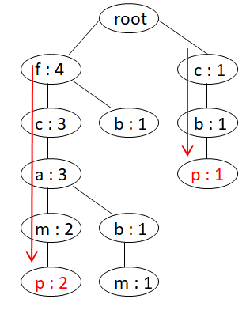
Mining Frequent Pattern from Tree
Mining frequent patterns by breaking down the problem into more manageable sub-problems:
1. For each item in the tree find all paths (excluding item) that lead to the item (Conditional pattern base)
e.g., for p : {(f, c, a, m:2), (c, b:1)}
2. Find frequent items in these paths (Conditional FP-tree)
e.g., frequent items of {(f, c, a, m:2), (c, b:1)} based on support=3: (c:3)
3 . Extract all possible itemsets using the item combined with these frequent items (Frequent Patterns)
e.g., combination of p with (c:3) : p:3, pc:3

Slide 46
Frequent Patterns from FP-tree - Example
Start from the bottom of the header table (p)
Two paths
p’s conditional pattern base
{(f, c, a, m:2), (c, b:1)}
p’s conditional FP-tree
Only one branch (c:3)
Frequent Patterns:
p:3, pc:3
root
f : 4
c : 1
c : 3
b : 1
b : 1
Header Table
a : 3
p : 1
item
head of node-links
f
m : 2
b : 1
c
a
b
p : 2
m : 1
m
p
minimum support threshold = 3

Slide 47
Frequent Patterns from FP-tree - Example
Continue with the node before node p in the table (m)
Two paths
m’s conditional pattern base
{(f, c, a:2), (f, c, a, b:1)}
m’s conditional FP-tree:
(f:3, c:3, a:3)
Frequent Patterns:
m:3,
mf:3, mc:3, ma:3,
mfc:3, mfa:3, mca:3,
mfca:3
root
f : 4
c : 1
c : 3
b : 1
b : 1
Header Table
a : 3
p : 1
item
head of node-links
f
m : 2
b : 1
c
a
b
p : 2
m : 1
m
p
minimum support threshold = 3

Slide 48
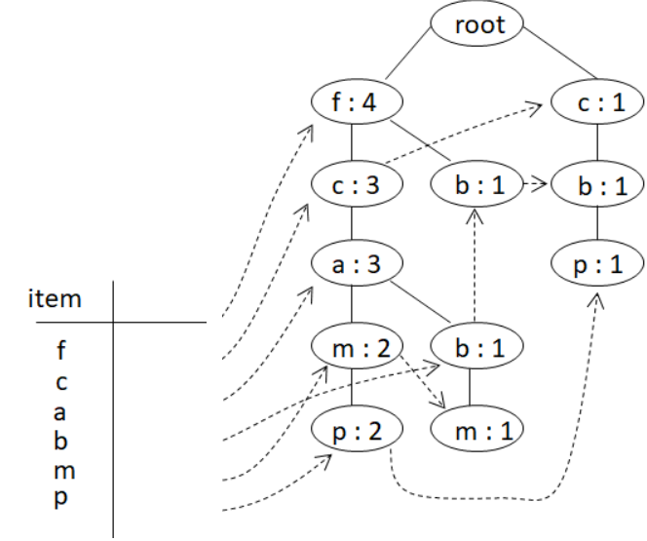
Frequent Patterns from FP-tree - Example
Item | Conditional pattern base | Conditional FP-tree | Frequent Patterns
p | {(f, c, a, m:2), (c, b:1)} | {(c:3)} | cp:3, p:3
m | {(f, c, a:2), (f, c, a, b:1)} | {(f:3, c:3, a:3)} | m:3, am:3, cm:3, fm:3, cam:3, fam:3, fcm:3, fcam:3
b | {(f, c, a:1), (f:1), (c:1)} | Φ | b:3
a | {(f, c:3)} | {f:3, c:3} | fca:3, fa:3, ca:3, a3
c | {(f:3)} | {(f:3)} | c:4, fc:3
f | Φ | Φ | f:4
Frequent Itemsets-1 = {(f:4), (c:4), (a:3), (b:3), (m:3), (p:3)}
minimum support threshold = 3

Slide 49
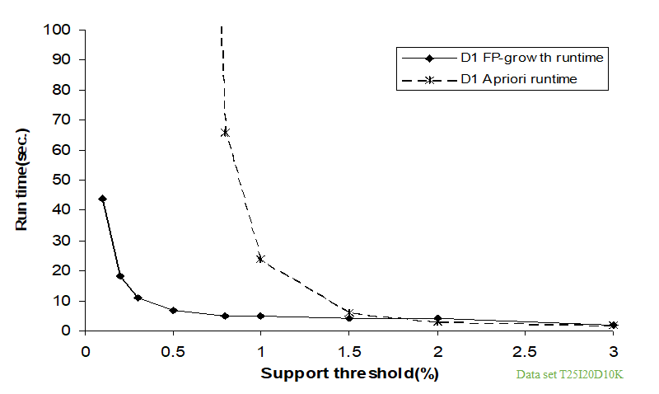
Advantages of the FP-Growth
Reduce number of comparison since a tree structure is used
Does not generate candidate itemsets which can be infrequent
It is compact since there is no infrequent node in tree also no redundant paths
FP-Growth scans the database only twice, one for individual items and one for building tree
Scalable and efficient for large datasets

Slide 50
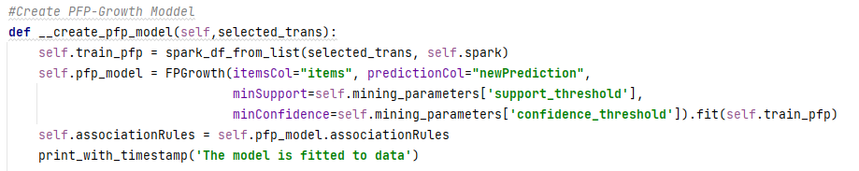
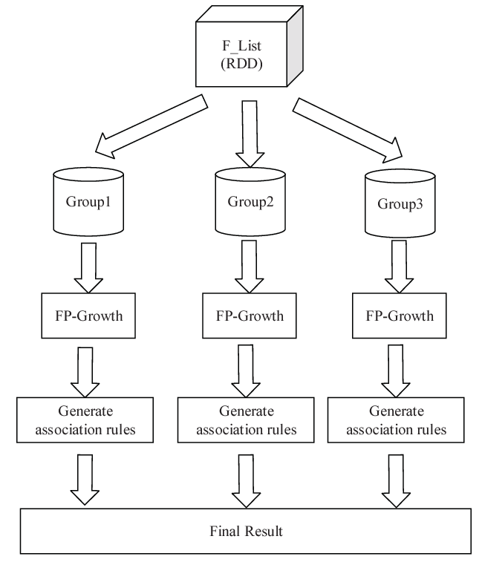
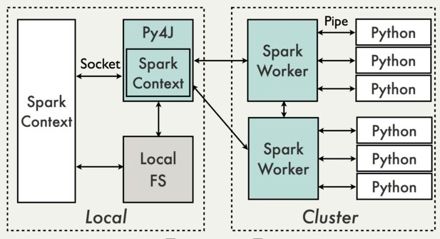
Parallel FP-Growth Algorithm
FP-Growth algorithm can be implemented for parallel processing to improve scalability and speed on big data (e.g., PFP-Growth in PySpark)
Each worker builds a conditional FP-tree for its assigned pattern(s)

Slide 51
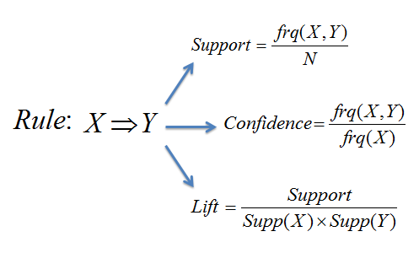
Mining Association Rules
Steps:
Finding Frequent Itemset
Generate all itemsets whose support ≥ minsup
Rule Generation
Generate high confidence rules from each frequent itemset with a length bigger than one, where each rule is a binary partitioning of a frequent itemset

Slide 52
Rule Generation
Given a frequent itemset L, find all non-empty subsets f ⊂ L such that f → L – f satisfies the minimum confidence requirement:
If {A,B,C,D} is a frequent itemset, candidate rules:
ABC →D ABD →C ACD →B BCD →A A →BCD B →ACD C →ABD D →ABC AB →CD AC → BD AD → BC BC →AD BD →AC CD →AB
If |L| = k, then there are 2^{k} – 2 candidate association rules

Slide 53
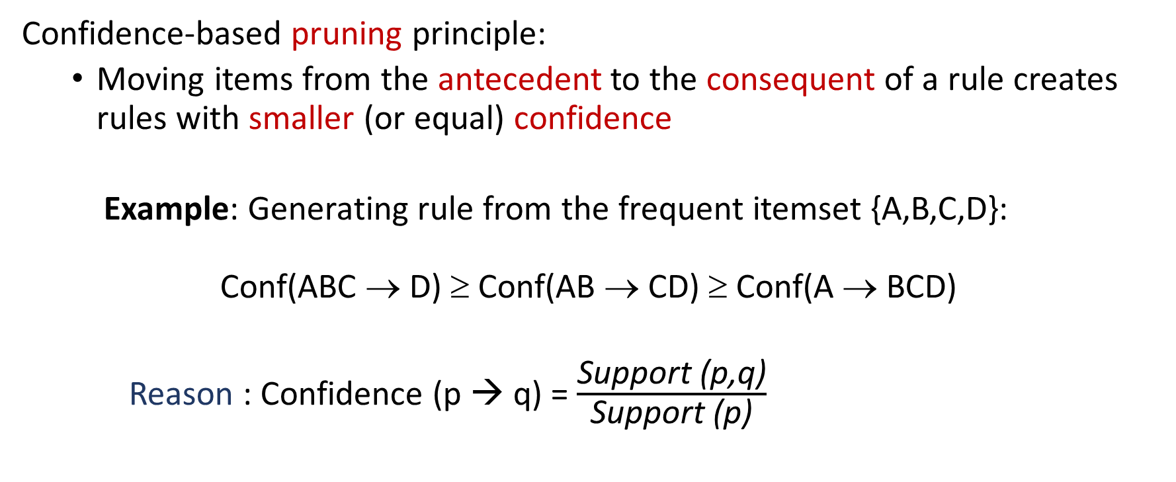
Efficient Rule Generation
Confidence-based pruning principle:
Moving items from the antecedent to the consequent of a rule creates rules with smaller (or equal) confidence
Example: Generating rule from the frequent itemset {A,B,C,D}: Conf(ABC → D) ≥ Conf(AB → CD) ≥ Conf(A → BCD)
Reason : Confidence (p → q) = $\frac{\text{Support}\text{ (}\text{p}\text{,}\text{q}\text{)}}{\text{Support} \text{(}\text{p}\text{)}}$

Slide 54
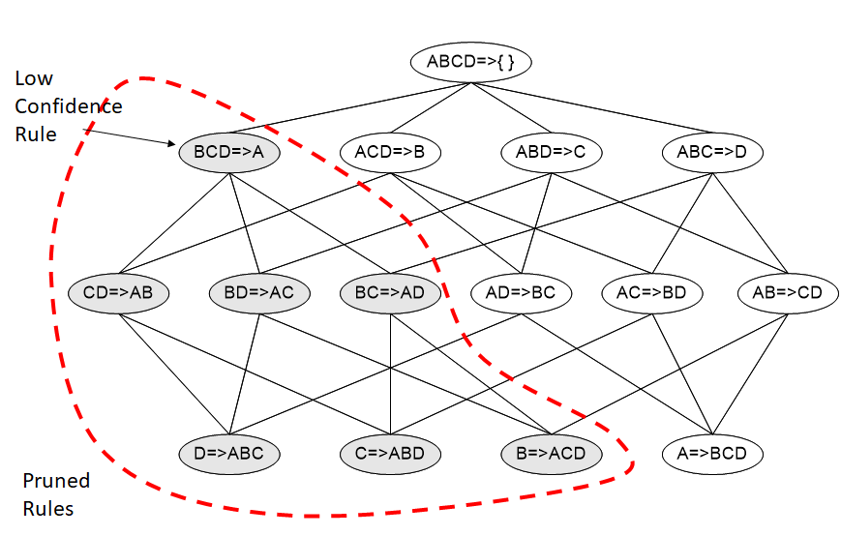
Rule Generation - Pruning
If a rule doesn’t meet the confidence threshold, then all rules formed by moving items from its antecedent to its consequent can be pruned

Slide 55
Avoid Redundancy in Rule Generation
When mining frequent itemsets, many itemsets are subsets of others with the same support:
Suppose {A, B} is not closed, but {A, B, C} is closed
Suppose {A, B} and {A, B, C} both occur in 100 transactions. Then {A, B} doesn’t add new information, since every time {A, B} appears then {C} appears
When association rules are generated from only closed itemsets:
Avoid rules derived from subsets that don’t add new information.
Significantly reduces the number of redundant rules while still preserving all essential patterns
All Frequent Itemsets: {A, B} , {A, B, C} : A → B , A → BC , …
Closed Frequent Itemsets: {A, B, C}: A → BC , …

Slide 56
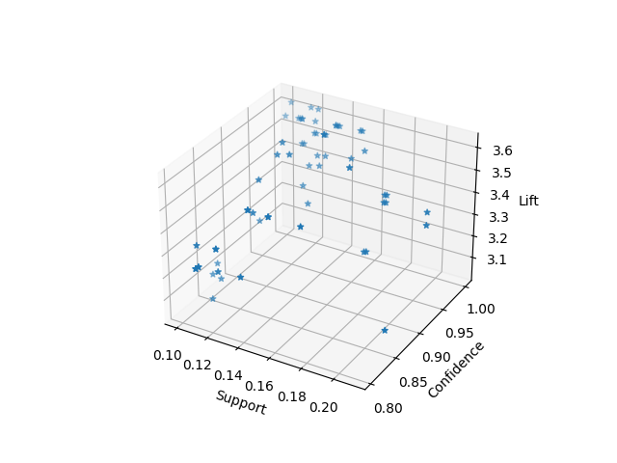
Thresholds of Interestingness Measures
How to set the appropriate support threshold?
If min-sup is set too high, we could miss itemsets involving interesting rare items (e.g., expensive products)
If min-sup is set too low, it is computationally expensive and the number of itemsets is very large. Also, it is possible to include noise data.
How to set the appropriate confidence threshold?
Confidence threshold should provide reasonable reliability regrading the context of study
How to set the appropriate lift threshold?
Lift threshold should filter associations which are not strong (e.g., lift < 1.2)
Avoid thresholds which find no rules, or thousands
Rank rules by their lift values and select a threshold which is suitable
Thresholds are subjective guided by domain knowledge, research goals, best practices, and the judgment of subject matter experts

Slide 57
Association Rule Advantages & Disadvantages
Advantages:
Finding hidden and complex patterns in data that is not recognizable with simple correlation analysis.
Rules contain measures like support, confidence, and lift which provide valuable information about prevalence, predictive power , and correlation of items
A white-box model provides interpretable results.
Disadvantages:
Finding the appropriate parameter and threshold settings for the mining algorithm is not straight forward
Results are dependent to the training data and with different training datasets results can be completely different (High Variance).

Slide 58
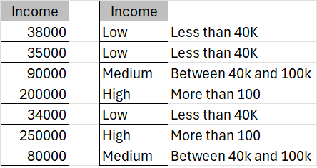
Data Pre-processing for Association Rule
Missing Values are not required to be imputed, since different number of items in transactions is not an issue.
Normalizing data is not recommended since frequency and other interestingness measures are not affected by scale of items. On the other hand, it reduces interpretability of the results.
Filter out outliers is not required for most cases in which frequency of outliers is less than the support threshold.
Discretizing is recommended for range variables with many different values which makes them less frequent

Slide 59
Discretizing using Range Variables
Range variables can be used to convert the continuous values into different ranges
Ranges can be recognized using the binning or opinion of subject matter experts
Employee | Years With Company | Salary (x1,000) | Position | Department
1 | 2 | 70 | Manager | Sales
2 | 23 | 105 | Head | HR
3 | 2 | 37 | Assistant | Production
4 | 3 | 70 | Associate | Analytics
5 | 16 | 85 | Senior Manager | Production
Discretizing
Employee | Years With Company | Salary (x1,000) | Position | Department
1 | 0-3 | 65-85 | Manager | Sales
2 | 20-30 | 86-110 | Head | HR
3 | 0-3 | 20-39 | Assistant | Production
4 | 0-3 | 65-85 | Associate | Analytics
5 | 11-20 | 65-85 | Senior Manager | Production

Slide 60
Tabular Data to Transactional Data
Transactional Format (Required for Rule Mining): Each row represents a single transaction containing a set of items.
Tabular Data (Common in Databases): Each row represents a set of attributes
Student | CSC 365 | CSC 366 | CSC 480 | CSC 437 | CSC 408 | CSC 481
1 | A | B | B
2 |  |  |  | A |  | A
3 | C | C |  |  | B
4 | C |  | B |  | A
5 |  |  | A
6 | C |  | B |  | B
One-hot Encoding
Student | CSC 365-A | CSC 365-B | CSC 365-C | CSC 366-A | CSC 366-B | …
1 | 1 |  |  |  | 1
2
3 |  |  | 1
4 |  |  | 1
5
6 |  |  | 1

Slide 61
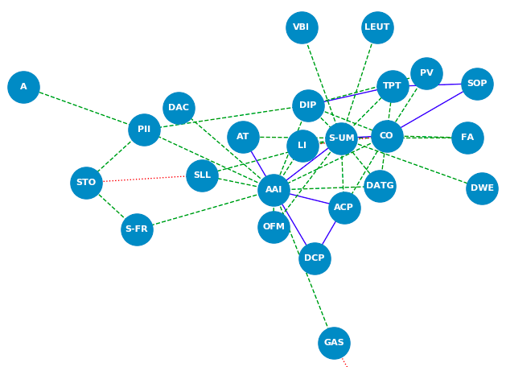
Applications of Association Rules
ARM is valuable in domains where interpretability and explainability are important
Domain experts and decision-makers can directly understand and discover knowledge from rules
- Healthcare and Medicine
- Bioinformatics and Genomics
- Social Science / Social Networks
- Fraud Detection/ Financial Risk Assessment
- …
Social Network
Waseeb et al., 2020

Slide 62
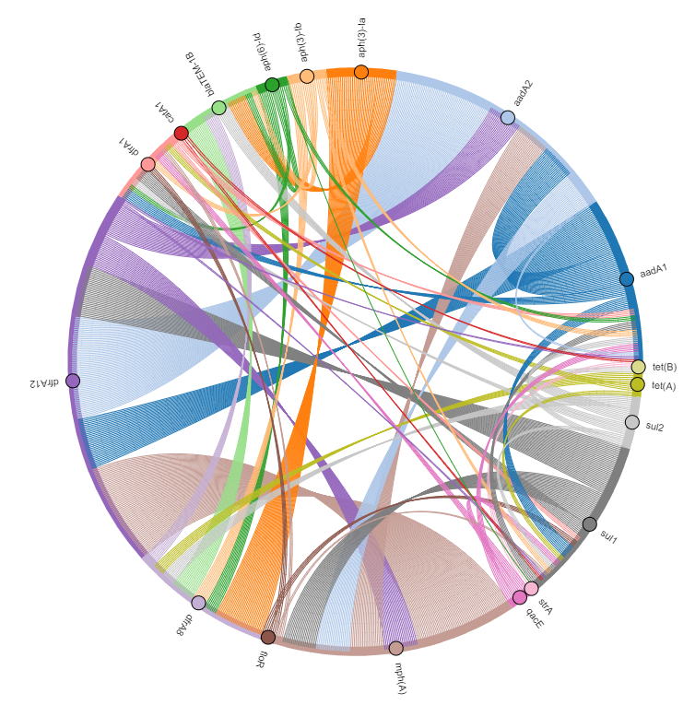
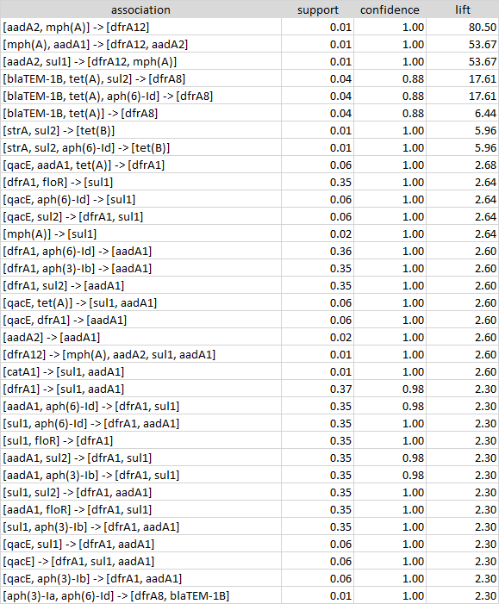
Applications of Association Rules - Example

Slide 63
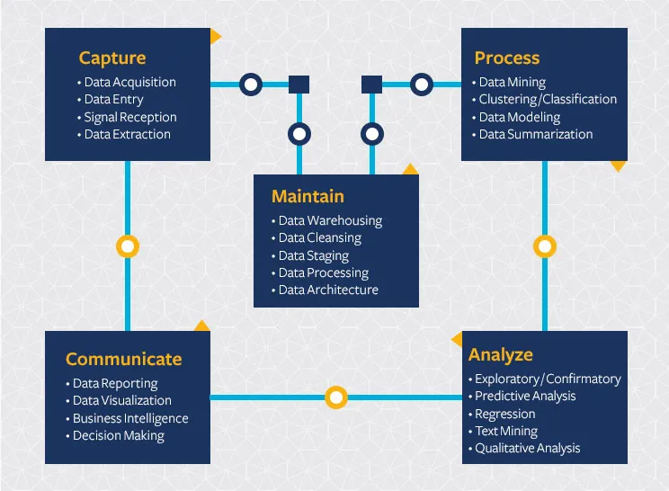
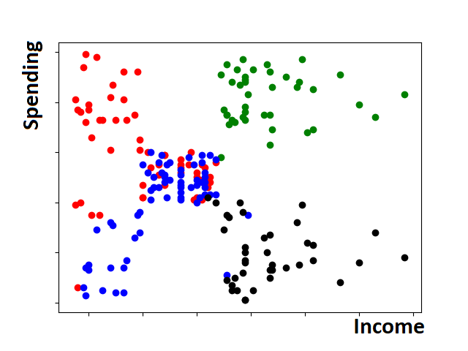
Data Visualization
Data visualization is an important part of data science
Data visualization is translating information into a visual context to:
Find patterns, trends, and structures in data
Condense information
Absorb information clearly and quickly
Data visualization make data easier for the human brain to understand and pull insights from.
Berkeley

Slide 64
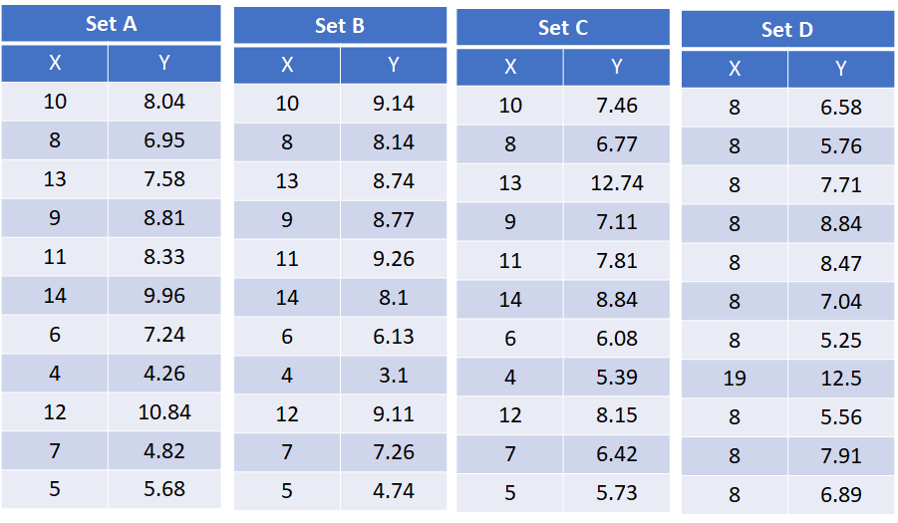
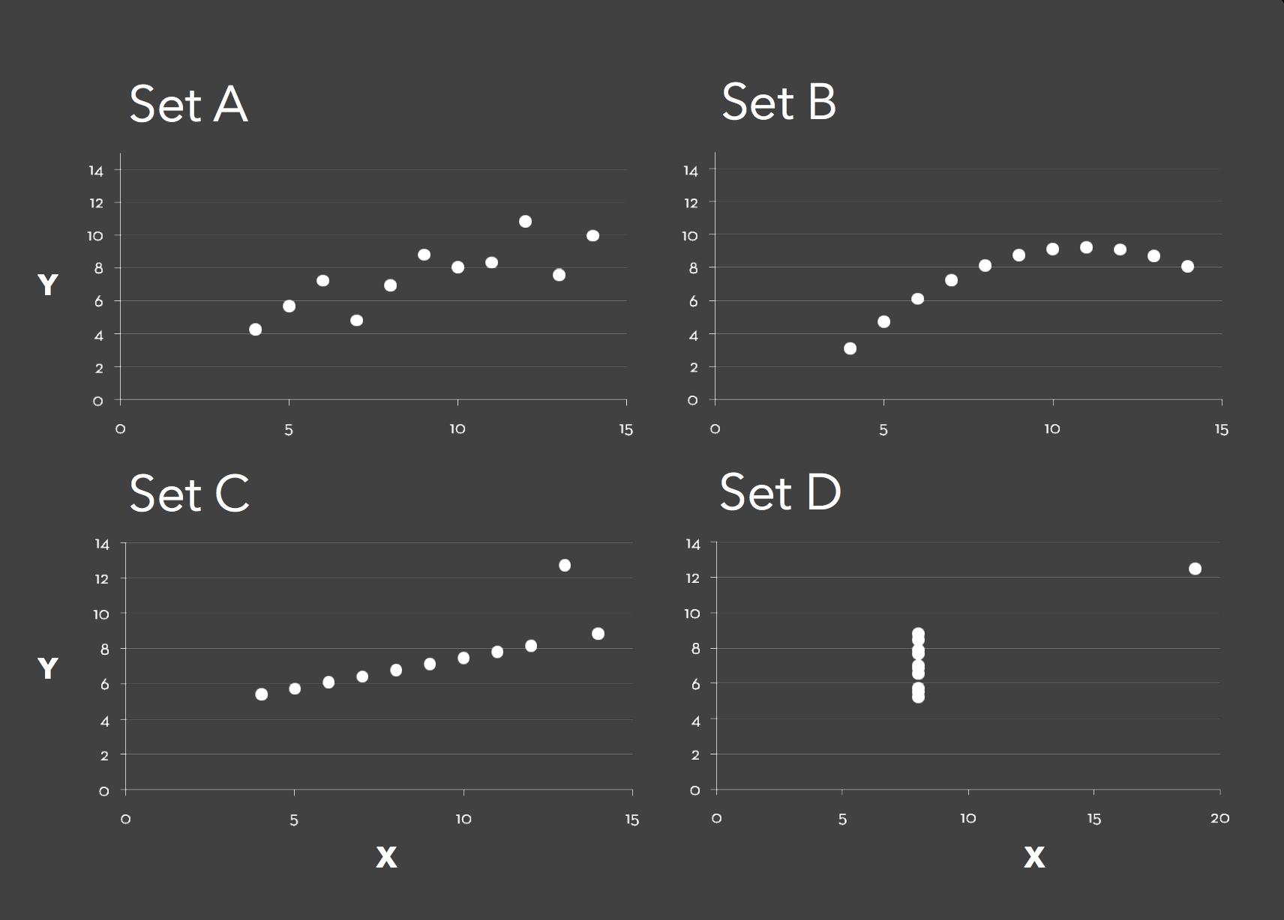
Visual Communication
93% of information transmitted to the brain is visual.
The human brain processes images around 60,000 times faster than text
What are characteristics of a good visualization?

Slide 65
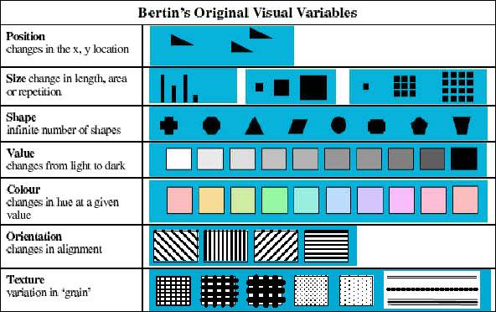
Visual Variables
Visual variables are differences in graphic elements as perceived by the human eye which can be used to encode and visualize data efficiently
Jacques Bertin proposed an original set of visual variables. The list has since been further expanded by other researchers:
Transparency
Color saturation
Arrangement
Resolution
Etc.

Slide 66
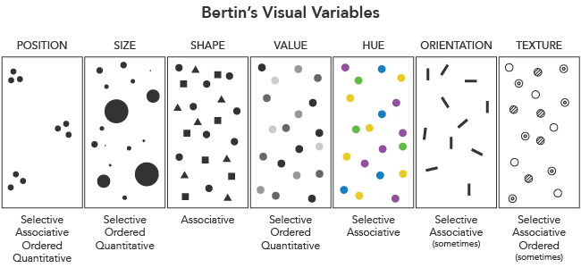
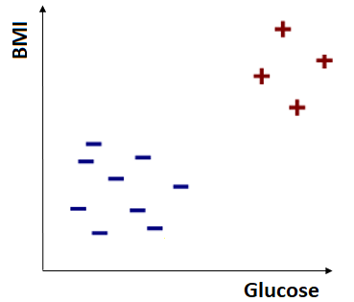
Visualizing Relationships in Data
Visual variables can encode different types of relationships in data visualization.
The main types of relationships that can be encoded using visual variables are:
Selective Relationships
Associative Relationships
Quantitative Relationships
Ordered Relationships

Slide 67
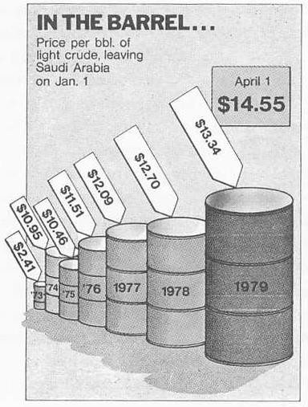
Visual Design - Graphical Integrity
Visualization shouldn’t mislead the reader (lie)
Tufte’s “Lie Factor”:
_{𝐿𝑖𝑒 𝐹𝑎𝑐𝑡𝑜𝑟 =} 𝑠𝑖𝑧𝑒 𝑜𝑓 𝑒𝑓𝑓𝑒𝑐𝑡 𝑠ℎ𝑜𝑤𝑛 𝑖𝑛 𝑔𝑟𝑎𝑝ℎ𝑖𝑐
𝑠𝑖𝑧𝑒 𝑜𝑓 𝑒𝑓𝑓𝑒𝑐𝑡 𝑖𝑛 𝑑𝑎𝑡𝑎
Lie factor should be around 1
Lie factor bigger than 1 indicates exaggerated
Lie factor less than 1 indicates understated
𝐿𝐹 =
4280% (𝑐ℎ𝑎𝑛𝑔𝑒 𝑖𝑛 𝑣𝑜𝑙𝑢𝑚𝑒)
= 9.4
454% (𝑐ℎ𝑎𝑛𝑔𝑒 𝑖𝑛 𝑝𝑟𝑖𝑐𝑒)

Slide 68
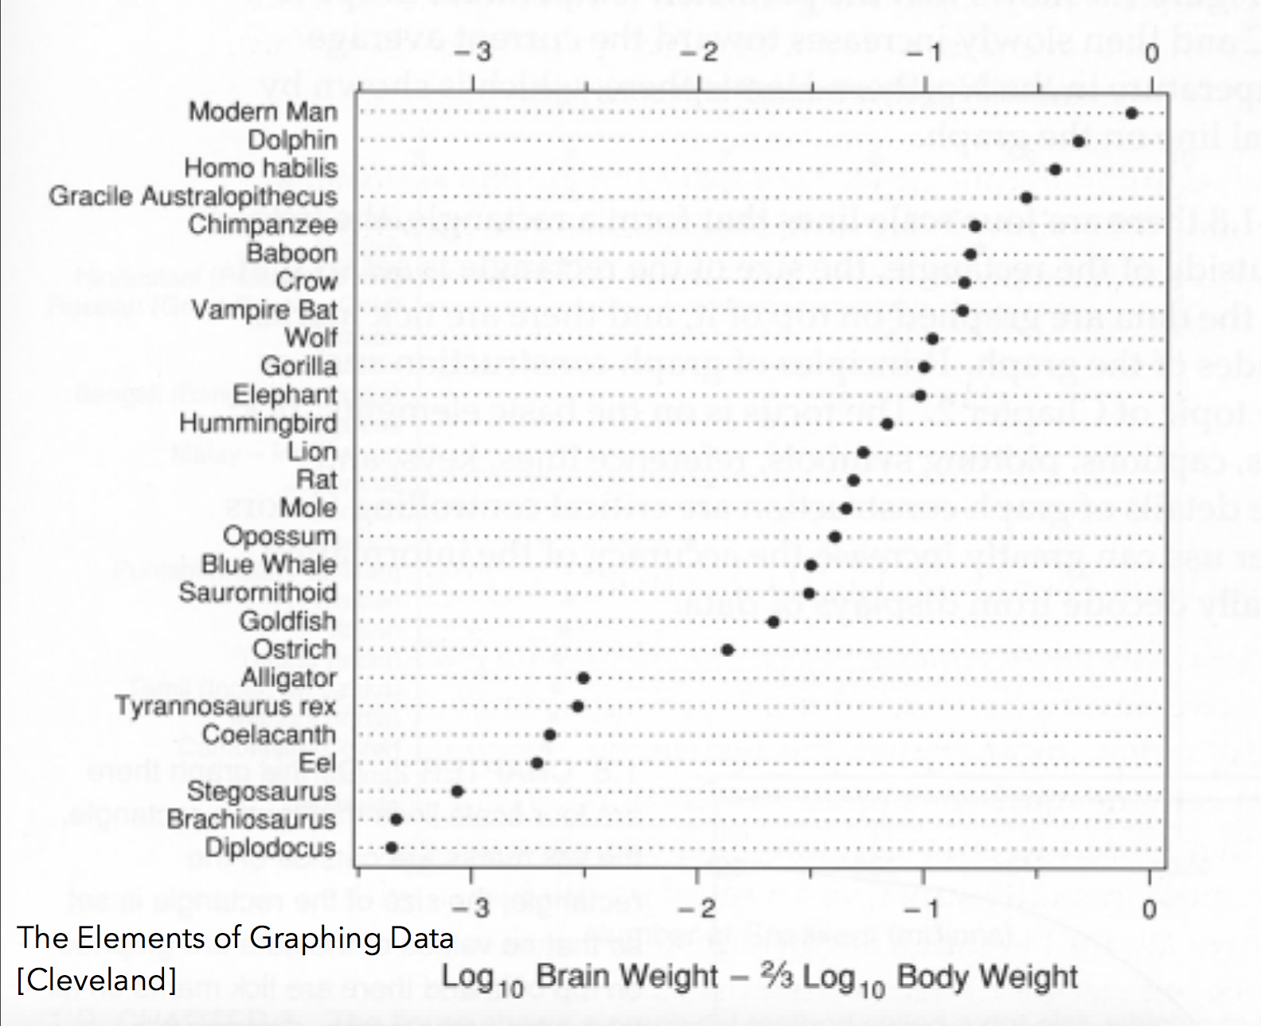
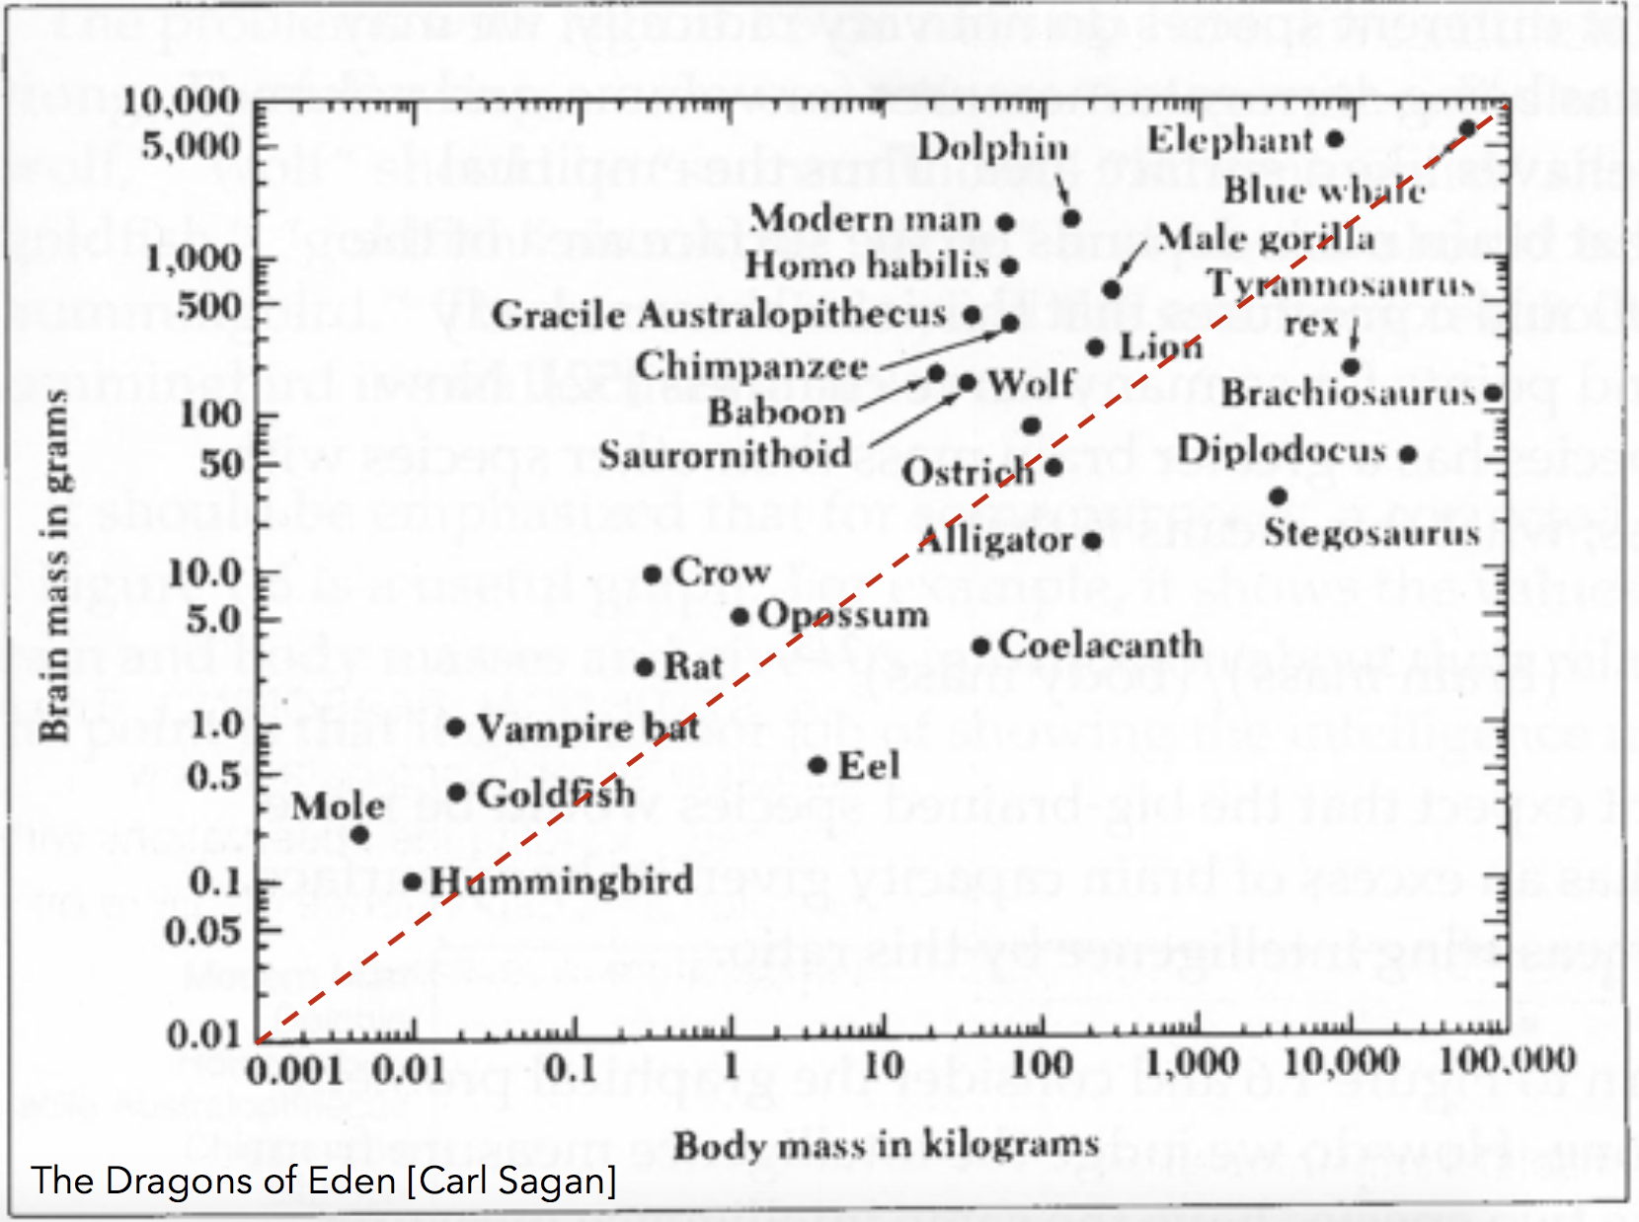

Visual Design – Answer Question
Visualization should be designed to answer a specific question or communicate insights clearly.
The choice of visual variables, chart type, and layout should be guided by the underlying question
Question: Is brain mass to body mass ratio an important factor for intelligence?
The same data

Slide 69
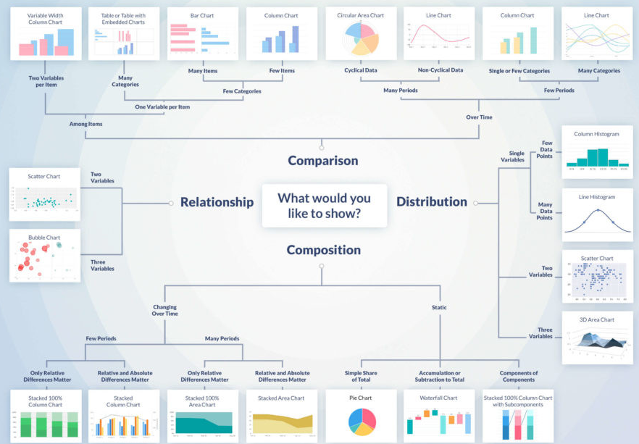
Data Visualization Types
Relationship: Show relationships or correlations between variables
Distribution: Show how values are distributed across a dataset.
Change over time (Time-Series): Focused on data evolving over time
Comparison : Used to compare values across categories or over time.
Composition: Used to display parts of a whole
Flows and processes: Used to display flows between stages or categories
Geographical data: Used for mapping data
…
tapclicks

Slide 70
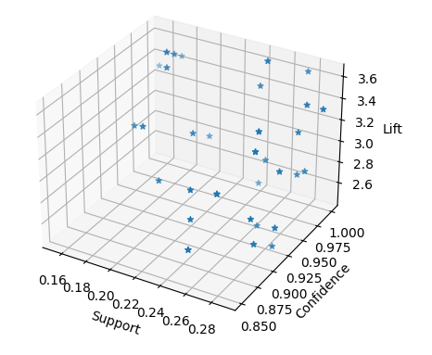
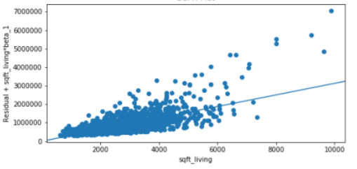
Relationship
Association Rule Mining
Scatter plot
Standard chart type for showing relationships between numeric variables. Each point's position on an axis indicate value on the associated variable.
Data objects are plotted as a point in a 2d / 3d-plane
import matplotlib.pyplot as plt # Create scatter plot plt.scatter(x, y, color='blue') # Customizations plt.xlabel('X-axis') plt.ylabel('Y-axis') plt.legend() plt.show()
Regression

Slide 71
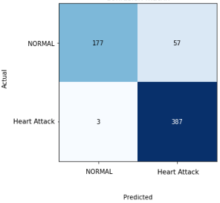
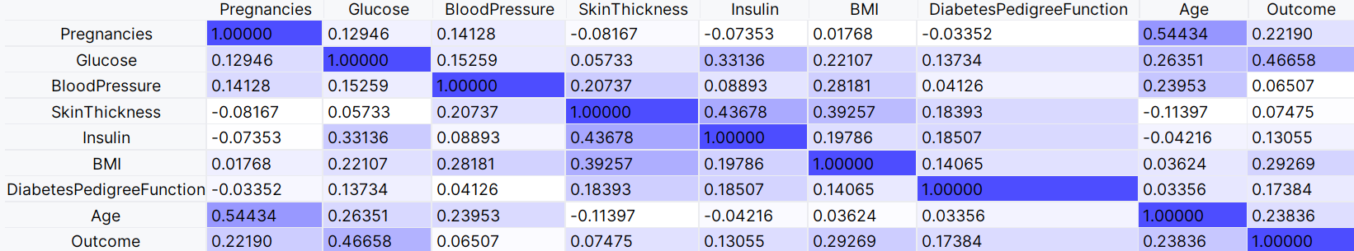
Relationship
Confusion Matrix
Heatmap
Each axis represents groups or bins of values for one of the variables forming a grid.
Cell colors indicate data frequency, correlation, or a summary of a third variable for each intersection of axis variables.
import seaborn as sns import matplotlib.pyplot as plt # Create a heatmap sns.heatmap(data, annot=True, cmap='Blues’) plt.show()
1
Correlation between features

Slide 72

Relationship
Dendrogram
Specialized chart type to show similarity between data points
The lower the branch connecting two data points, the more similar they are.
Hierarchical Clustering
from scipy.cluster.hierarchy import linkage, dendrogram import matplotlib.pyplot as plt
#Agnes
linkage_data = linkage(train_feat, method='single', metric='euclidean') dendrogram(linkage_data, truncate_mode = 'level' ,p=7 ) plt.show()
Similarities between datapoints

Slide 73

Relationship
Chord diagram
Nodes represent individual entities arranged in a circle
Edges connect entities with a particular relation­ship
Number of lines may be used to encode value
Association Rule Mining
import holoviews as hv hv.extension('bokeh') # Create the Chord diagram chord = hv.Chord((matrix, labels)) # Display the plot chord.opts(width=600, height=600)
Associations between Genes

Slide 74

Relationship
Tree diagram
A network diagram organized to show hierarchical re­lationships
The direction of each edge corresponds to a relationship between the connected nodes (e.g., par­ent--child )
Decision Tree
from sklearn import tree import matplotlib.pyplot as plt #Visualize the model plt.figure(figsize=(9,9)) tree.plot_tree(treemodel,feature_names=train_feat.columns) plt.show()
Parent child relationships

Slide 75

Distribution
Histogram
Similar to a bar chart but used when a variable takes continuous numeric values
The variable's numeric range is divided into bins for aggregating counts
Bars are plotted flush against each other to emphasize the continuous nature.
Histogram (10 bins)
import matplotlib.pyplot as plt # Create a histogram plt.figure(figsize=(8, 6)) plt.hist(data, bins=10) plt.xlabel('Value') plt.ylabel('Frequency') plt.show()
Bins of equal width

Slide 76


Distribution
Box plot
A box and whiskers shows the range of the most common data values.
More often used to compare distributions between groups
Box plots can be used to detect outliers
import seaborn as sns import matplotlib.pyplot as plt # Create a box plot plt.figure(figsize=(8, 6)) sns.boxplot(data, x=age) plt.show()

Slide 77

Change Over Time (Trend)
Line Chart
Most common chart type for showing change over time (time-series)
A point is plotted for feature's value in each time period
Points are connected by line segments to emphasize progression across time
Time-series data
import matplotlib.pyplot as plt plt.plot(y_train, color='red' ) plt.plot(predicted_y, color='blue' ) plt.xlabel('Time') plt.ylabel('Passengers') plt.legend(["Real", "Predicted"], loc="lower right") plt.show()

Slide 78




Many Other Visualizations
Scatter map - Geographical Data
Sankey chart - Flows
Stacked bar chart - Composition
Bar Chart - Comparison

Slide 79

Assignment 5
Use suitable data preprocessing methods, including binning for age variable and converting tabular format to transactional (using one-hot encoding), on amr_horse_ds.csv to prepare data for association rule mining.
Extract rules using all combination of the following hyper-parameters:
min_sup = [0.05, 0.1, 0.4]
min_conf= [0.70, 0.85, 0.95]
min_lift= [1.1, 1.5, 4]
For one combination of hyper-parameters which produces 20 to 50 rules, save the resulting rules and report hyper-parameters that produced it
Visualize Support, Lift and Confidence of rules in step 3

